Slide 1
Weather-Based Prediction Of Wind Turbine Energy Output: A Next-Generation Approach To Renewable Ener

Slide 2

Introduction to Wind Energy and Its Significance
Wind energy is a rapidly growing source of renewable power worldwide.
Accurate prediction of wind turbine output is essential for efficient energy management.
Next-generation approaches leverage advanced weather prediction models to improve accuracy.
1
Notes:
Image source: https://imgv2-2-f.scribdassets.com

Slide 3

Challenges in Wind Power Forecasting
Variability in wind speeds due to changing weather conditions complicates energy prediction.
Traditional models often lack precision, leading to grid instability.
Improving forecast accuracy is crucial for integrating wind power into energy systems reliably.
2
Notes:
Image source: https://i.pinimg.com

Slide 4
Role of Weather Data in Wind Energy Prediction
Weather parameters such as wind speed, direction, temperature, and pressure influence turbine output.
High-resolution weather data enables more precise modeling of wind behavior.
Incorporating real-time weather observations enhances the reliability of forecasts.
3
Notes:
Image source: https://i.pinimg.com

Slide 5

Next-Generation Prediction Models
Advanced models use machine learning algorithms to analyze complex weather patterns.
These models can adapt to new data, improving their predictive capabilities over time.
Integration of meteorological forecasts with turbine performance data is central to these approaches.
4
Notes:
Image source: https://imgv2-2-f.scribdassets.com

Slide 6
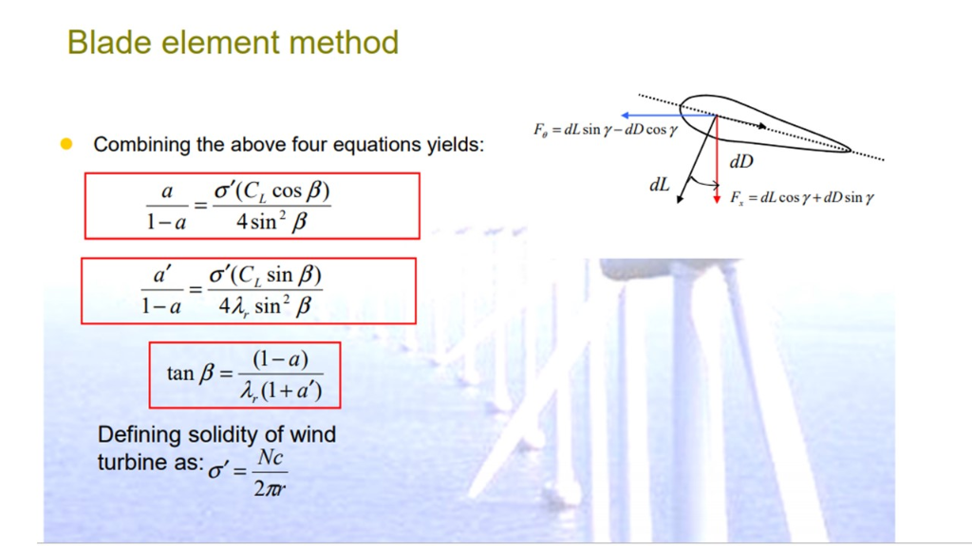
Machine Learning Techniques in Prediction
Techniques such as neural networks and ensemble learning are commonly employed.
They identify nonlinear relationships between weather variables and energy output.
These models outperform traditional statistical methods in dynamic weather conditions.
5
Notes:
Image source: https://media.cheggcdn.com

Slide 7
Data Collection and Processing
Accurate predictions require comprehensive datasets from weather stations, satellites, and turbines.
Data preprocessing involves cleaning, normalization, and feature selection.
Combining multiple data sources enhances the robustness of the forecasting models.
6
Notes:
Image source: https://www.researchgate.net

Slide 8
Case Studies and Applications
Several pilot projects demonstrate improved forecast accuracy using weather-based models.
These approaches help optimize turbine operation and maintenance scheduling.
They also contribute to better energy grid management and integration.
7
Notes:
Image source: https://www.researchgate.net

Slide 9
Benefits of Next-Generation Prediction Approaches
Increased forecast precision leads to higher energy production estimates.
Reduced operational costs by optimizing turbine performance.
Enhanced reliability and stability of renewable energy supply systems.
8
Notes:
Image source: https://media.cheggcdn.com

Slide 10
Future Directions and Research Opportunities
Incorporation of climate change models to account for long-term weather pattern shifts.
Development of real-time adaptive algorithms for instantaneous forecasting.
Expanding predictive frameworks to include other renewable sources like solar and hydro.
9
Notes:
Image source: https://i.pinimg.com

Slide 11
Conclusion and Outlook
Weather-based prediction represents a critical advancement in renewable energy management.
Next-generation models promise to unlock higher efficiencies and grid integration capabilities.
Continued research and technological development are essential for maximizing wind energy potential.
10
Notes:
Image source: https://i.pinimg.com

